Slide 1
Diabetes PREDICATION ASSESSMENT
Nehal Rani Sinha
Data analyst

Slide 2
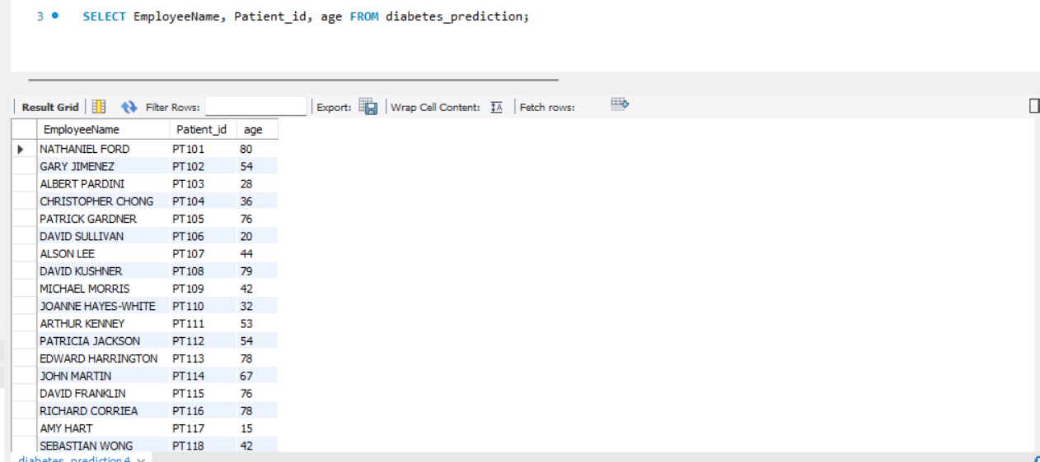
Retrieve the Patient_id and ages of all patients.

Slide 3
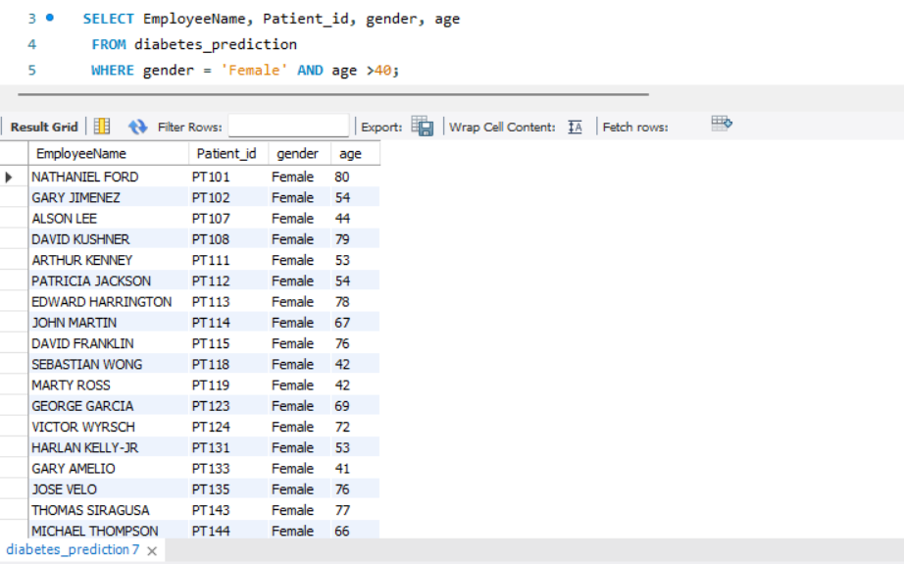
Select all female patients who are older than 40.

Slide 4
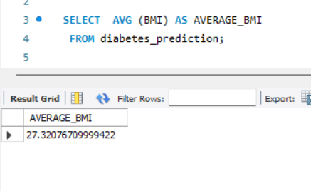
Calculate the average BMI of patients.
The average BMI of all patients is 27.321.

Slide 5
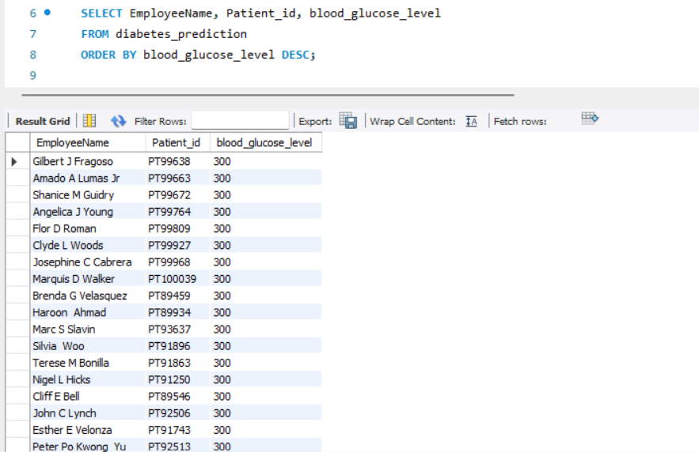
List patients in descending order of blood glucose levels.

Slide 6
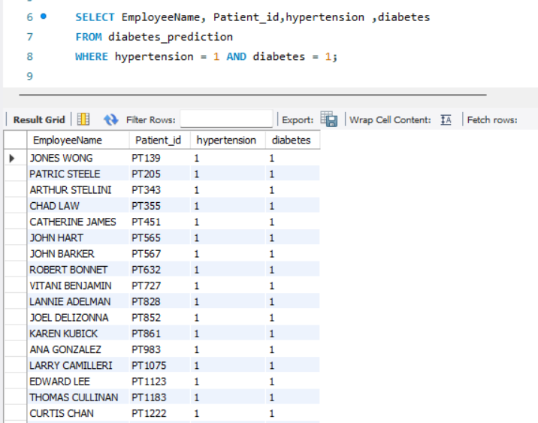
Find patients who have hypertension and diabetes.

Slide 7
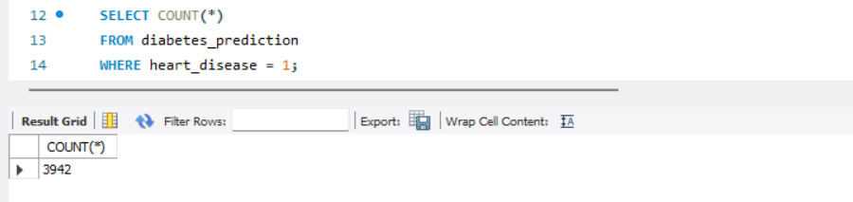
Determine the number of patients with heart disease.

Slide 8
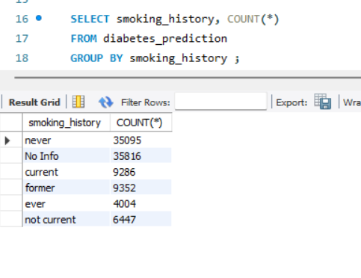
Group patients by smoking history and count how many smokers and non-smokers there are.

Slide 9
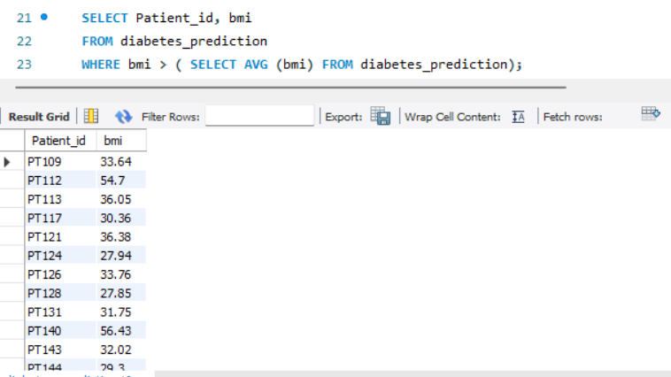
Retrieve the Patient_ids of patients who have a BMI greater than the average BMI.

Slide 10
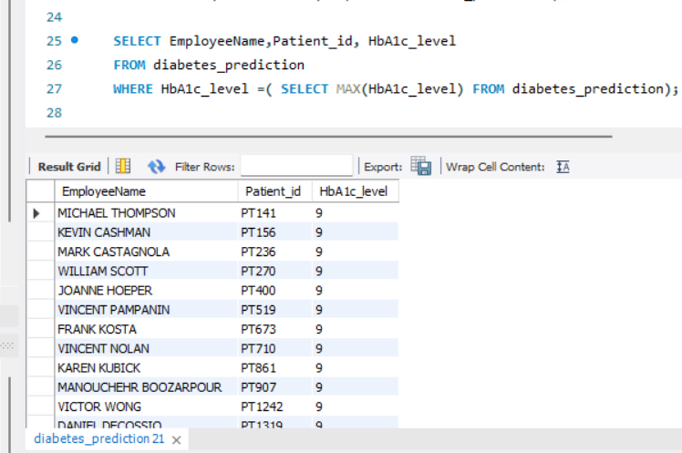
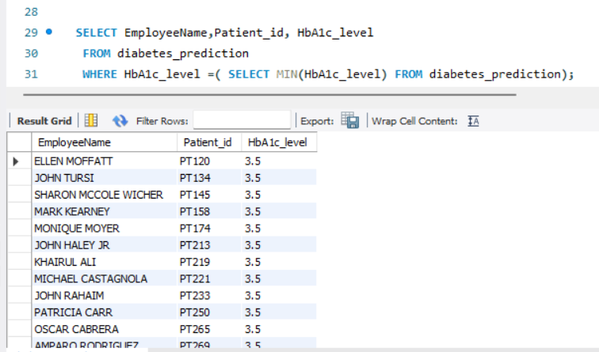
Find the patient with the highest HbA1c level and the patient with the lowest HbA1clevel

Slide 11
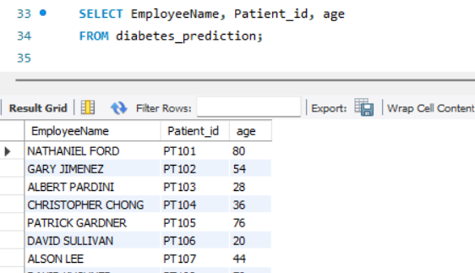
Calculate the age of patients in years (assuming the current date as of now).

Slide 12
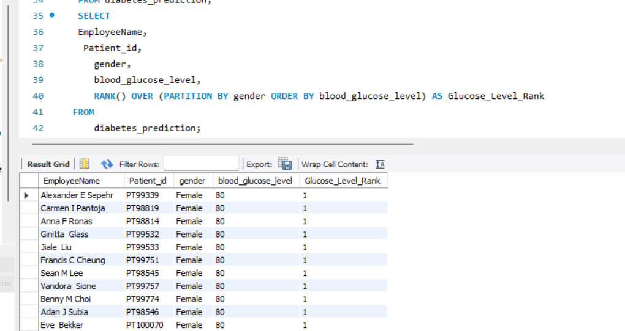
Rank patients by blood glucose level within each gender group.

Slide 13
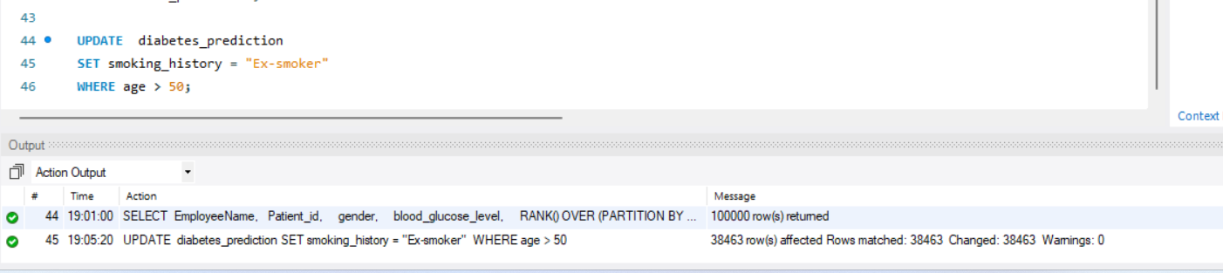
Update the smoking history of patients who are older than 50 to "Ex-smoker."

Slide 14
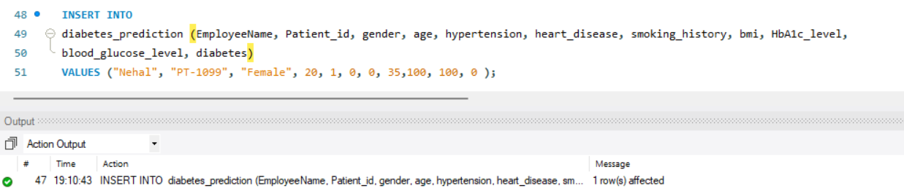
Insert a new patient into the database with sample data.

Slide 15
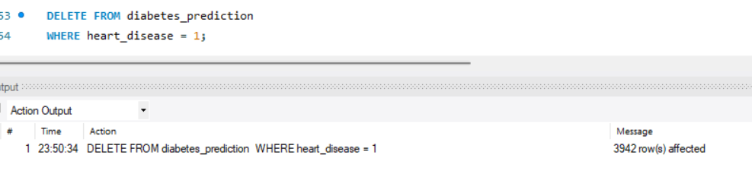
Delete all patients with heart disease from the database.

Slide 16
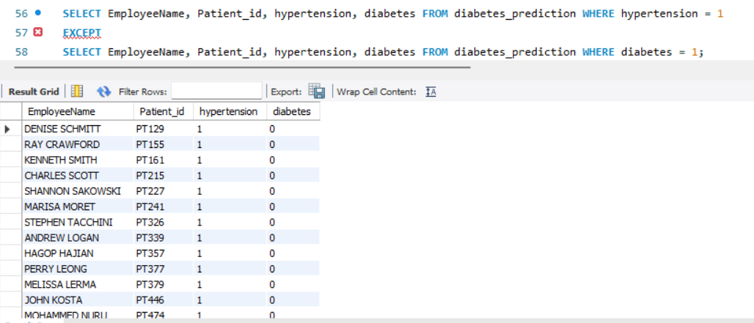
Find patients who have hypertension but not diabetes using the EXCEPT operator.

Slide 17
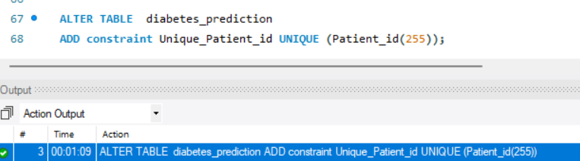
Define a unique constraint on the "patient_id" column to ensure its values are unique

Slide 18
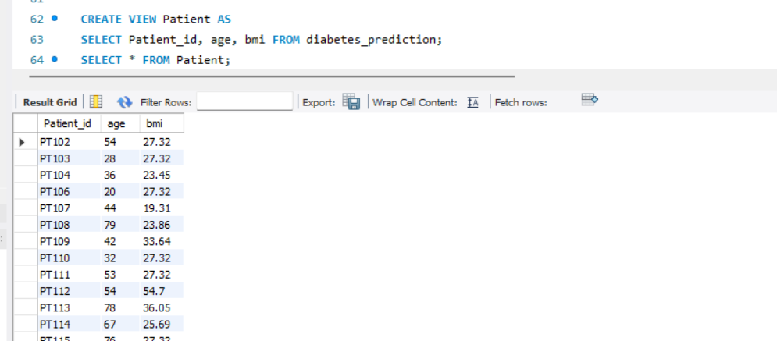
Create a view that displays the Patient_ids, ages, and BMI of patients.

Slide 19
Suggest improvements in the database schema to reduce data redundancy and improve data integrity.
Normalization: Break down large tables into smaller ones to minimize redundant data and dependency.
Use of Foreign Keys: Establish relationships between tables to ensure data integrity and prevent inconsistencies.
Unique Constraints: Enforce unique constraints on appropriate columns to avoid duplicate entries.
Denormalization when necessary: Consider demoralizing for performance but carefully balance it with normalization to maintain data integrity.
Regular Maintenance: Conduct regular audits and updates to identify and correct anomalies, ensuring long-term data consistency.
Data Types Optimization: Choose appropriate data types to minimize storage and enhance efficiency.
Indexing: Implement indexes strategically for faster data retrieval.

Slide 20
Explain how you can optimize the performance of SQL queries on this dataset.
1. Indexing: Create indexes on columns frequently used in WHERE clauses.
2. Query Optimization: Use efficient query writing techniques, such as avoiding SELECT * and specifying only necessary columns.
3. Normalization: Organize data into normalized tables to reduce redundancy and improve query speed.
4. Update Statistics: Regularly update statistics to help the query optimizer make informed decisions.
5. Partitioning: Partition large tables to speed up data retrieval.
6. Avoid Cursors: Use set-based operations instead of cursors for better performance.

